Slide 1
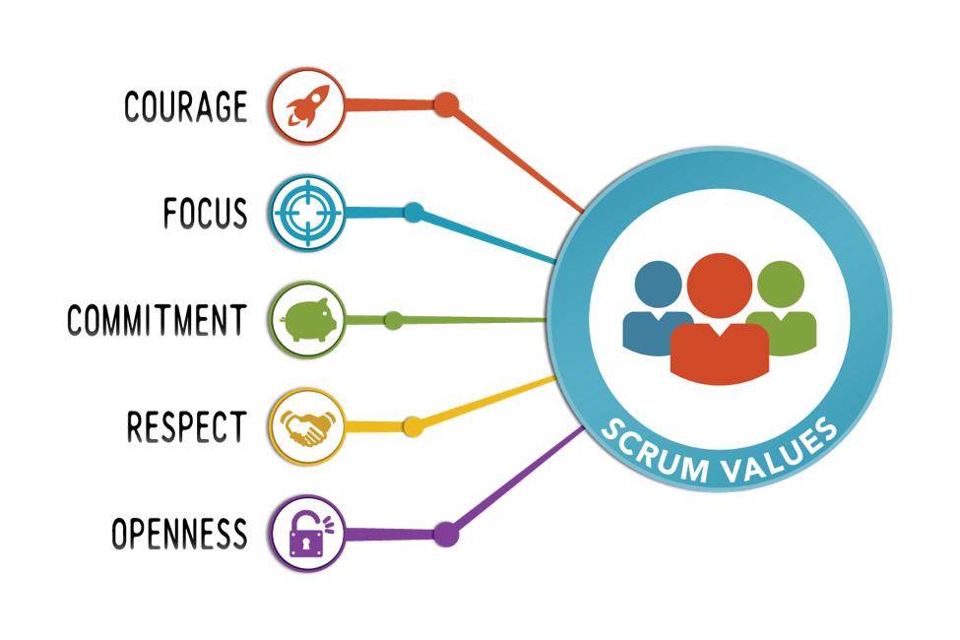
Scrum Agile Development Approach Sprint Review Summary and Agile Process Overview
Chada Tech SNHU Travel Project Author: Sarah Copeland

Slide 2
Scrum Roles
A Scrum team includes three core roles that work together to deliver value. The Product Owner manages the product backlog, sets priorities, and represents customer needs. The Scrum Master supports the team by guiding the Agile process and removing blockers. The Development Team designs, builds, and tests product increments during each sprint. These roles encourage shared ownership, collaboration, and iterative progress rather than siloed work.

Slide 3
Agile Phases in the SDLC
Agile follows the same phases as the SDLC but applies them iteratively. Requirements are captured as user stories in the product backlog. Design is lightweight and evolves throughout development. Development and testing take place within each sprint instead of being separated. Deployment occurs in increments and feedback drives improvement. Each sprint includes planning, execution, review, and retrospective which supports continuous learning and delivery.

Slide 4
Waterfall vs Agile
Waterfall development follows a strict sequence of phases which makes change difficult and delays feedback. Agile uses short sprints to deliver working features and allows new requirements to be added through backlog refinement. In Waterfall the project team learns whether the product meets expectations at the end. In Agile feedback begins early. This reduces risk and improves customer satisfaction. Agile was a better fit for the SNHU Travel project because the requirements evolved and flexibility was needed.

Slide 5
Choosing an Approach
Agile is ideal when requirements may change, delivery speed matters, and customer feedback is valuable. Waterfall works best when requirements are fixed and fully defined at the start. The SNHU Travel project benefited from Agile because it allowed the team to break down work, respond to change, and maintain progress. Scrum practices such as backlog prioritization, sprint planning, and retrospectives improved structure and delivery. Based on this experience Scrum should continue to be used at Chada Tech.

Slide 6
References
Project Management Institute. (2021). Agile Practice Guide. PMI. Scrum Alliance. (2023). Scrum Foundations. https://www.scrumalliance.org Korn Ferry. (2022). Leading Agile Teams. Korn Ferry Institute. Druckman, A. (2012). The Scrum Field Guide. Addison-Wesley.

